Slide 1
Workflow 1
27.03.2022
Status check

Slide 2
Data preprocessing
removed all columns with 0 variance (and filled with 0s)
removed columns with NaN values
data normalization
Resulting number of columns: 4953

Slide 3
Classifiers
Logistic Regression:
binary
multi class (errors supposed to be balanced by class weights)
Cross-validation:
10 folds (binary)
5 folds (multi class) - reason: little data

Slide 4
Feature selection - experiments
1:
Select the number of features we want to extract - [1, …, 10]
Run K-fold CV
For each selected number of features:
Extract the desired number of features that provide the best performance
If the performance does not improve further, stop the inner loop
Save the selected features for this fold to a vector
Run the K-fold CV with all features and the subset of selected features

Slide 5
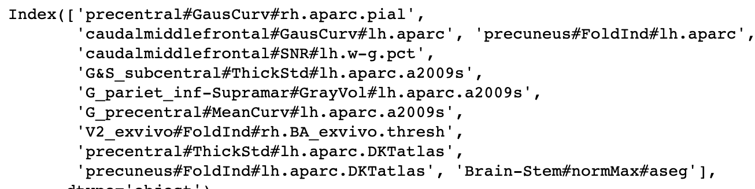
Experiment 1 - results - Binary:
Number of selected features: 11

Slide 6
Experiment 1 - Results - Binary
 | n of features | mean train error | mean test error
all features | 4953 | 0 | 0.388
subset of features | 11 | 0.273 | 0.29
random subset of features | 100 (different in each fold) | 0.1502 | 0.445

Slide 7
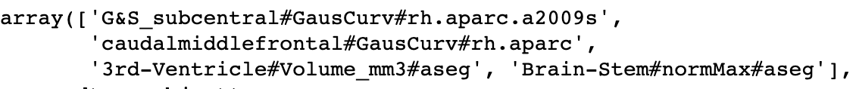
Experiment 1 - Results - Multi-class
Here, we show accuracy score, not MSE, so higher = better
Number of selected features: 4

Slide 8
Experiment 1 - Results - Binary
Here, we show accuracy score, not MSE, so higher = better
5 folds
 | n of features | mean train error | mean test error
all features | 4953 | 1 | 0.505
subset of features | 4 | 0.486 | 0.475
random subset of features | 100 (in each fold different) | 0.785 | 0.4255

Slide 9
Experiments with SHAP value
Train Logistic Regression model (binary) and then find the SHAP values
Save the SHAP values that exceed some importance threshold for each fold
Use the features with highest SHAP values in training the classifier

Slide 10
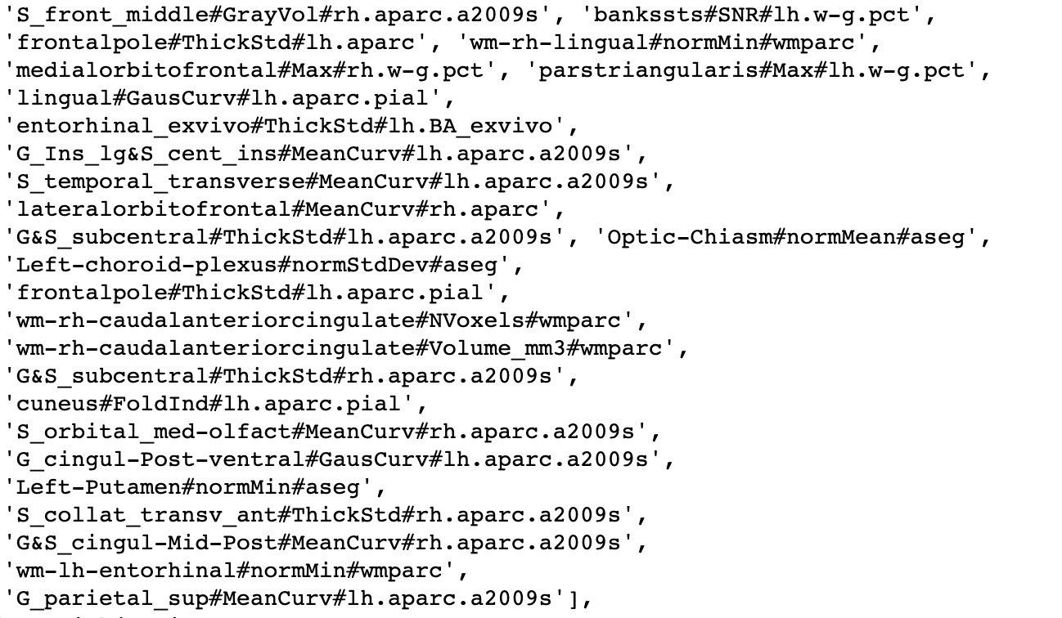
Selected features - binary

Slide 11
Experiment 1 - Results - Binary
 | n of features | mean train error | mean test error
all features | 4953 | 0 | 0.388
subset of features | 11 | 0.273 | 0.29
random subset of features | 100 (different in each fold) | 0.1502 | 0.445
SHAP experiment | 26 | 0.227 | 0.2901

